Slide 1

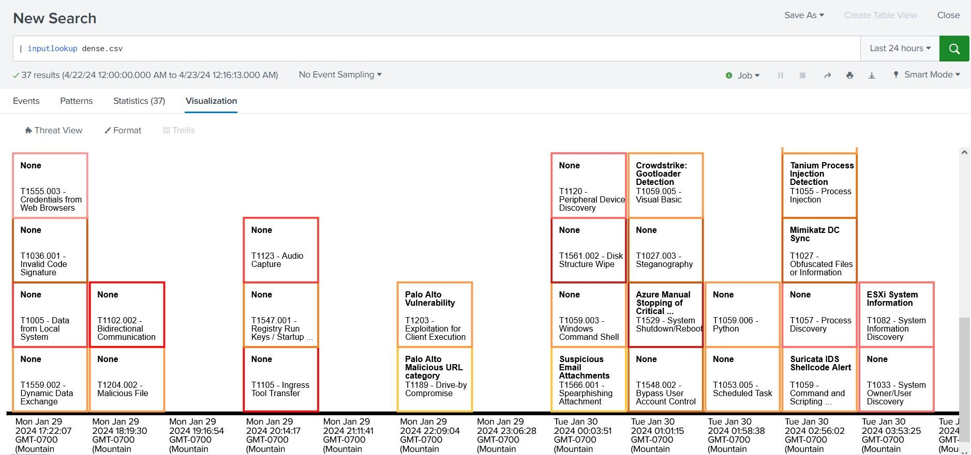
Say "Hello" to Threat View!
A new cyber defense tool for SPLUNK!
By: Danae O'Connor & Noah Warren

Slide 2
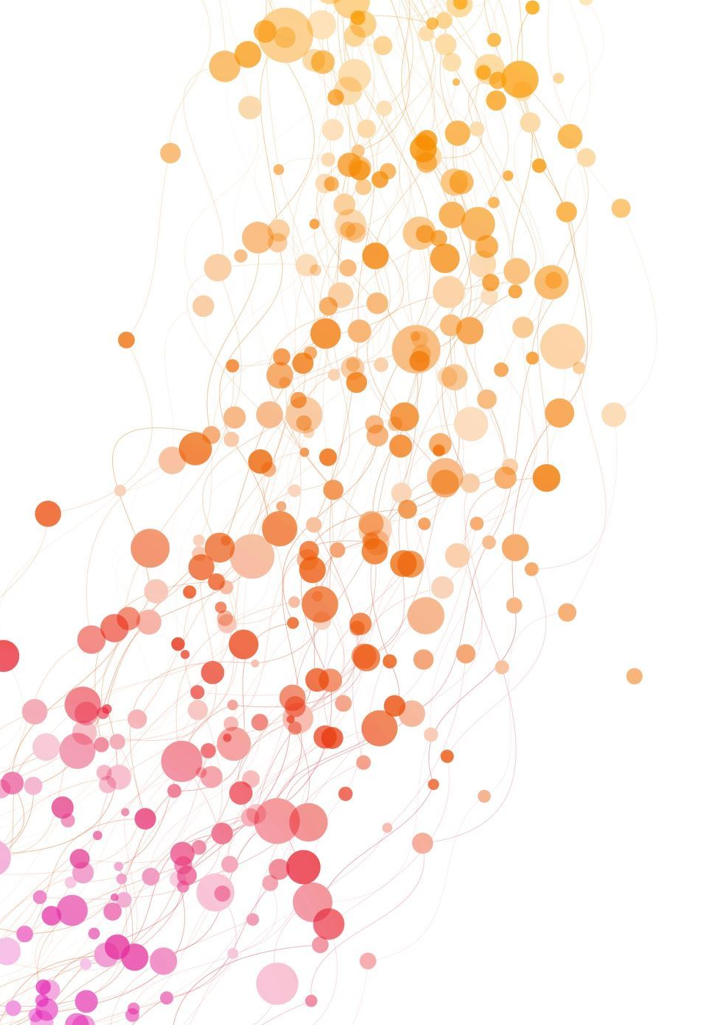
Did you know:
Cyber attacks happen about once every 39 seconds or 2,200 times per day based on conservative estimates.
There was a cyberattack every 39 seconds in 2023. (2024, January 8). Watch Guard. https://www.watchguard.com/wgrd-news/blog/there-was-cyberattack-every-39-seconds-2023#:~:text=According%20to%20a%20study%20by,incident%20occurred%20every%2044%20seconds
Notes:
The average cost of a single data breach in 2023 was $4.45 million.

Slide 3
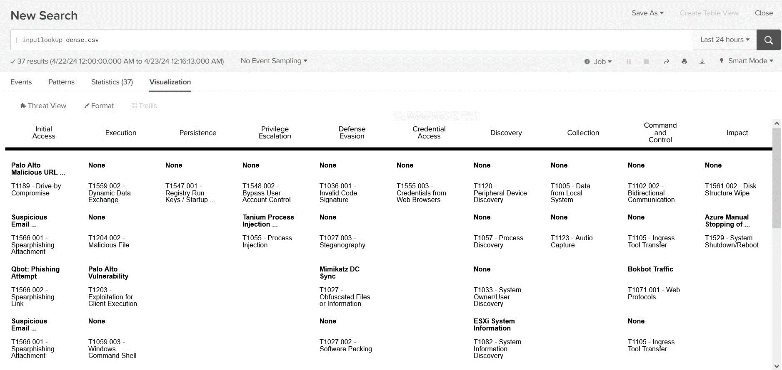
What is Threat View?
A visualization tool for Splunk Enterprise.
Helps track cyber attacks.
Graphically represents cyber attacks.
Aids in cyber attack analysis.

Slide 4
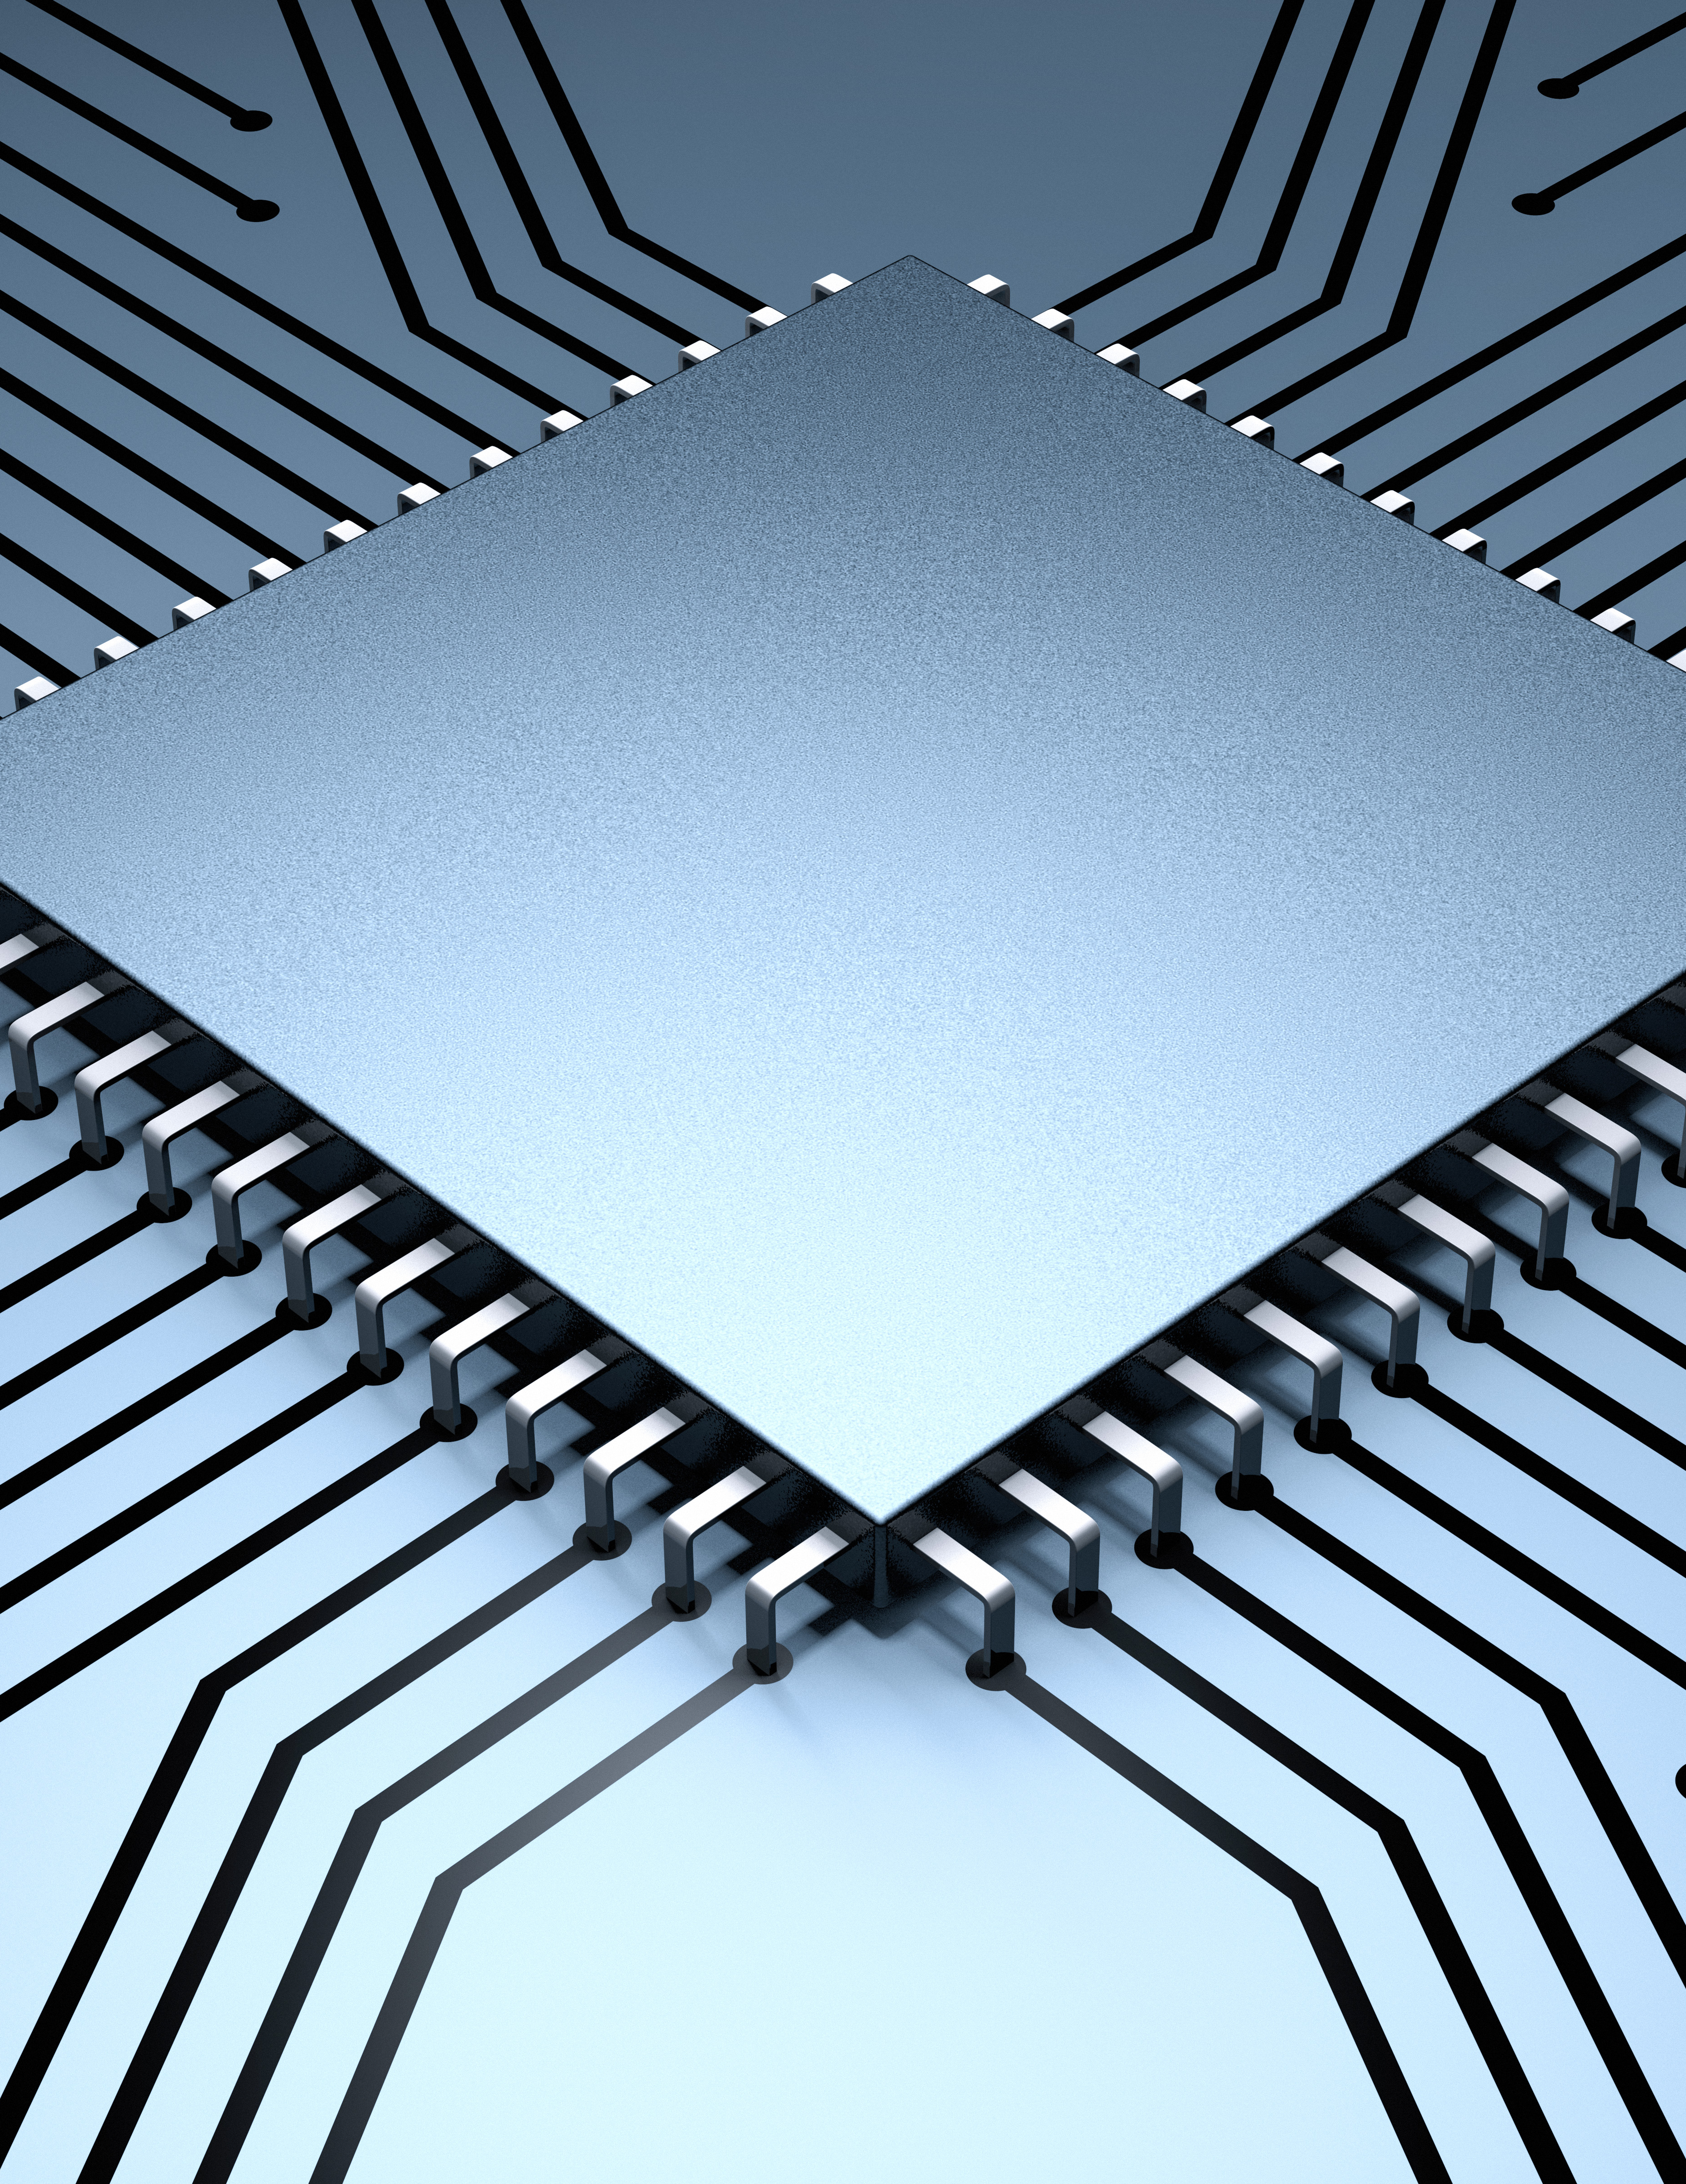
Requirements for Threat View:
Compatibility with Splunk Enterprise.
Designed around the MITRE ATT&CK database.
Cyber attacks are uniquely identifiable.
Simultaneous visualization of multiple attacks.
Attacks are categorized by severity or time.
Notes:
NEEDS A PIC

Slide 5
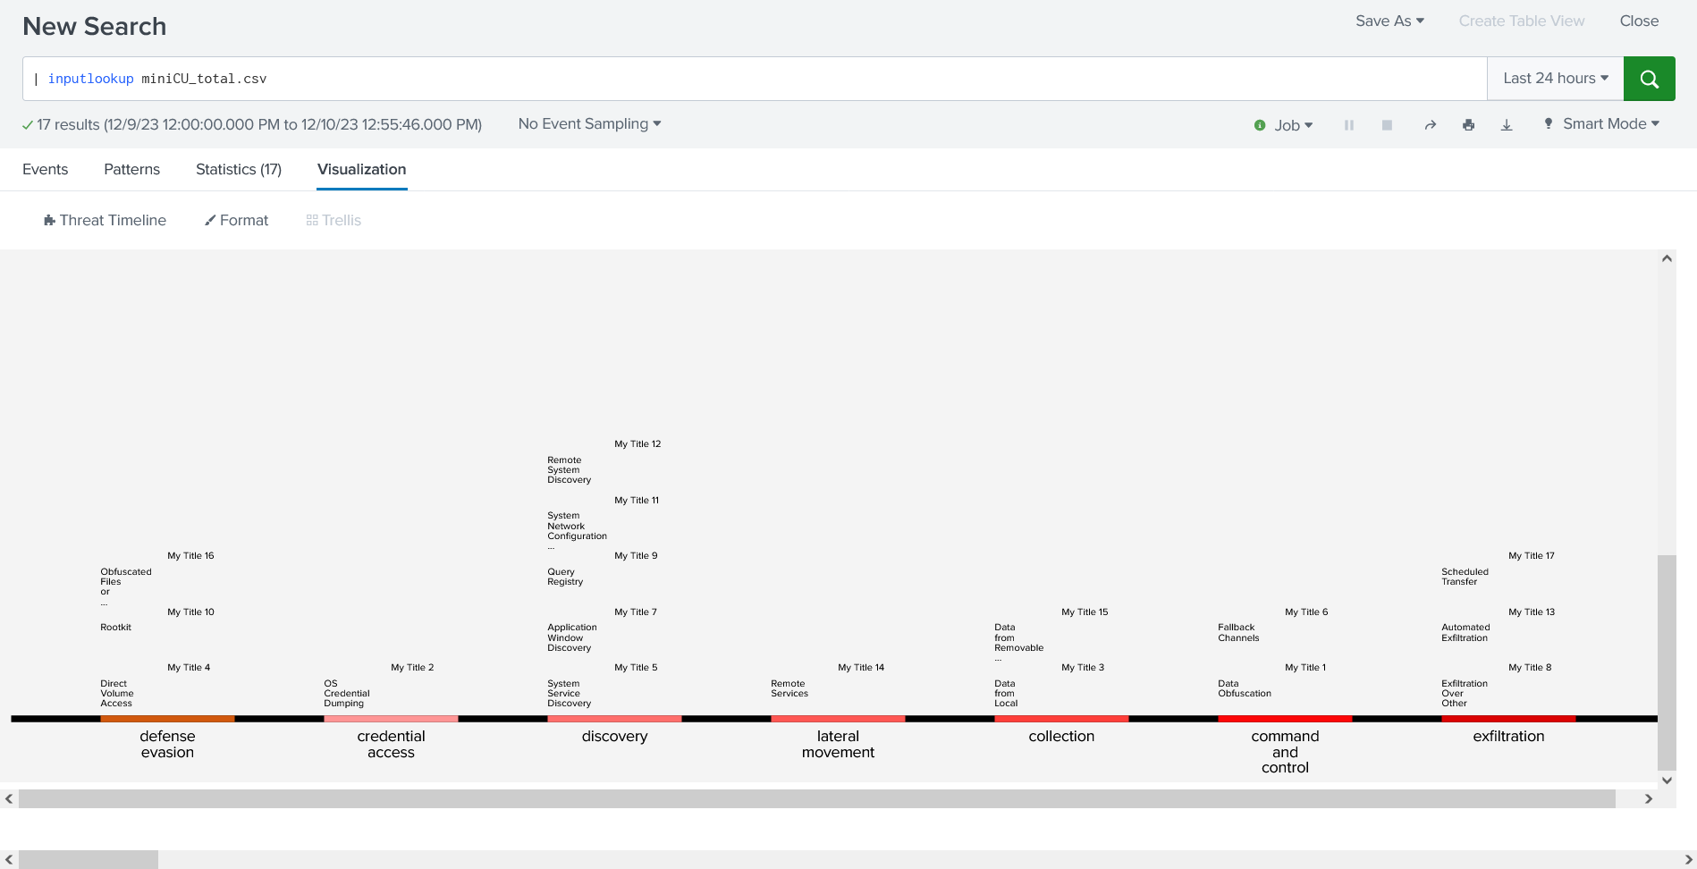
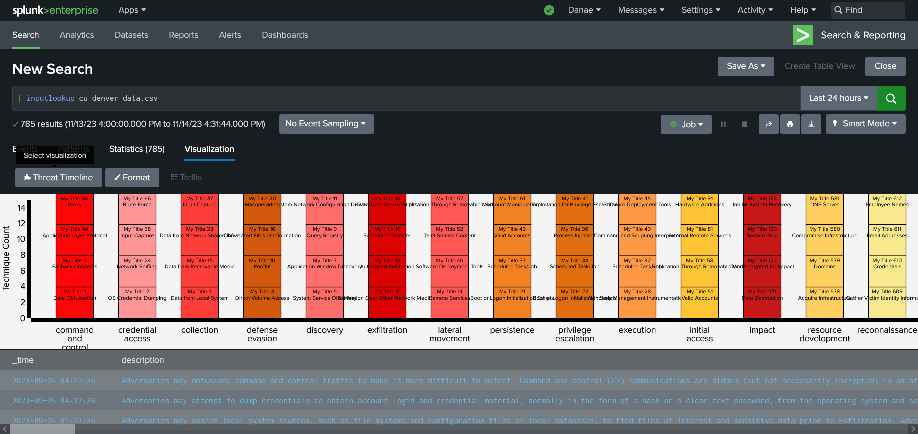
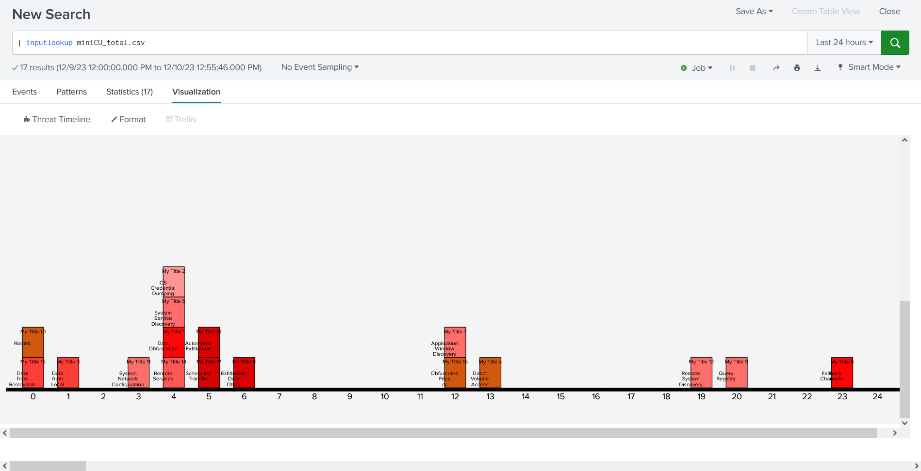
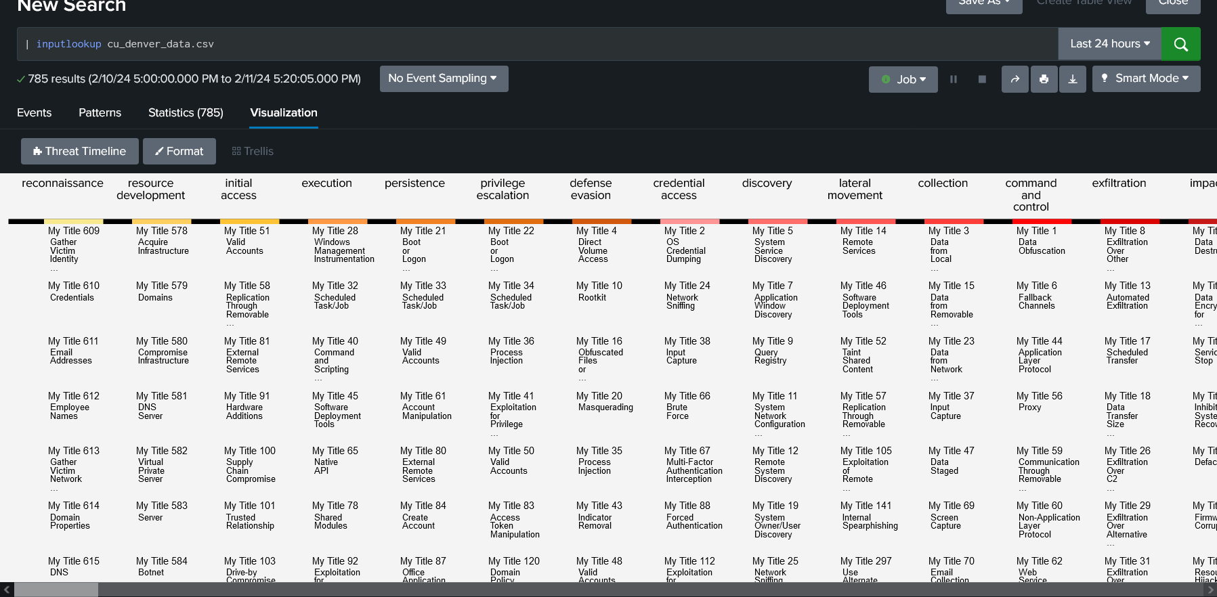
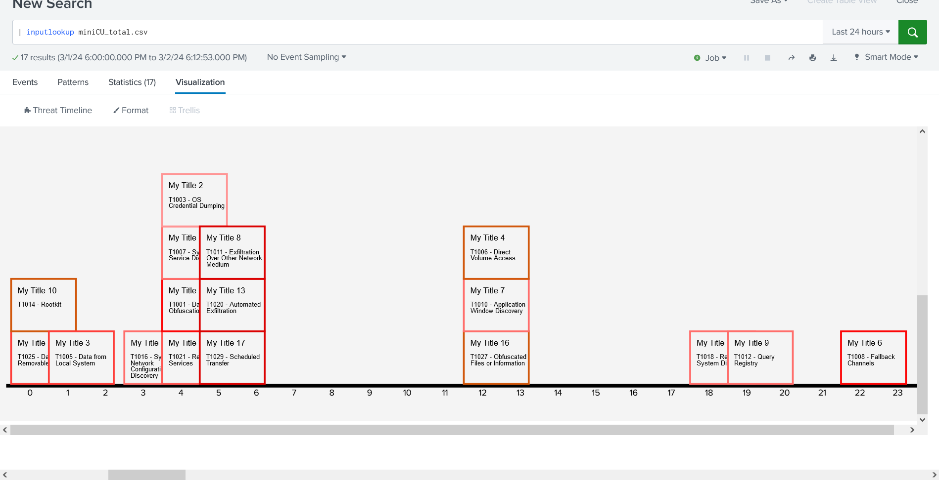
Initial Designs:
Two Distinct Views:
Tactic View
Timeline View
Notes:
BREAK THIS INTO 3:
Slide 1: Two distinct views
Slide 2: Cards & Tool Tips
Slide 3: Color & its evolution

Slide 6
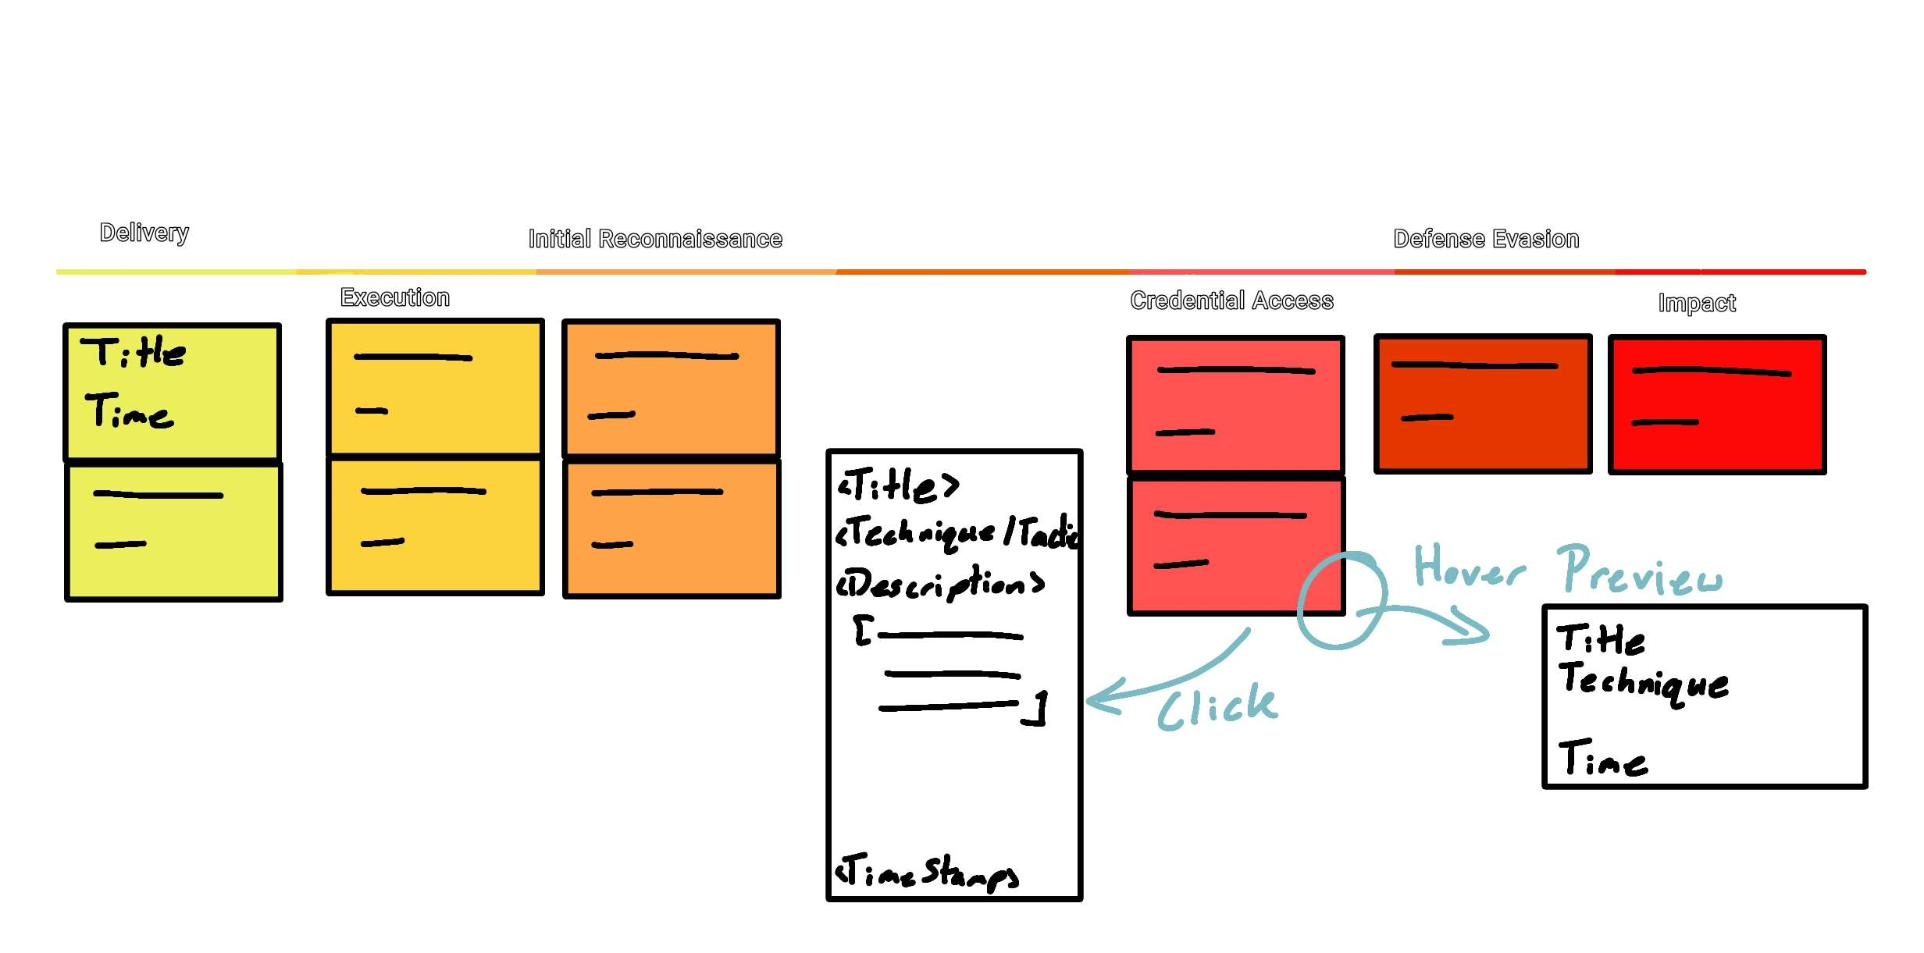
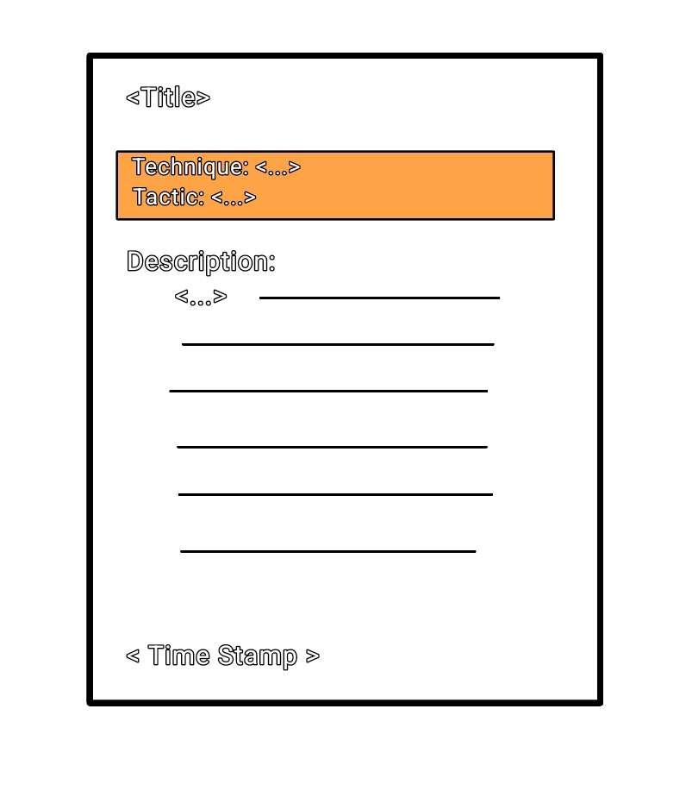
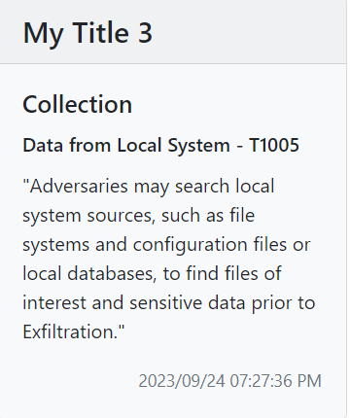
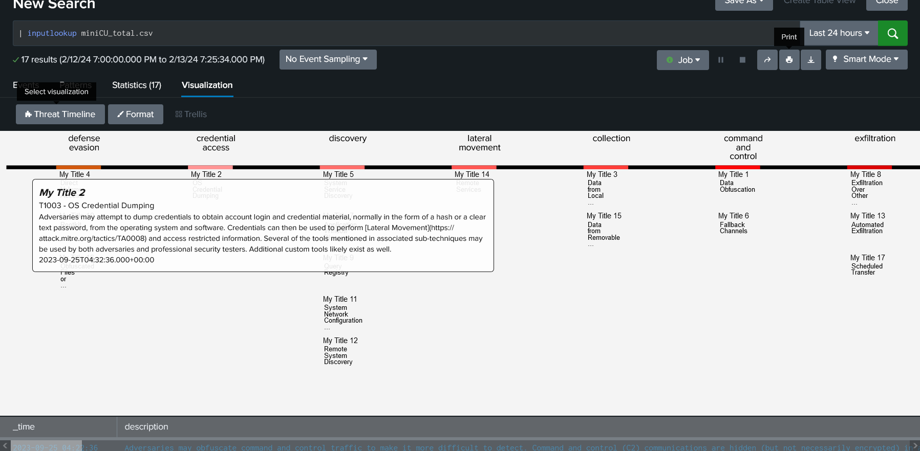
Initial Designs:
Cyberthreats represented as a "Card".
Card expansion functionality.

Slide 7

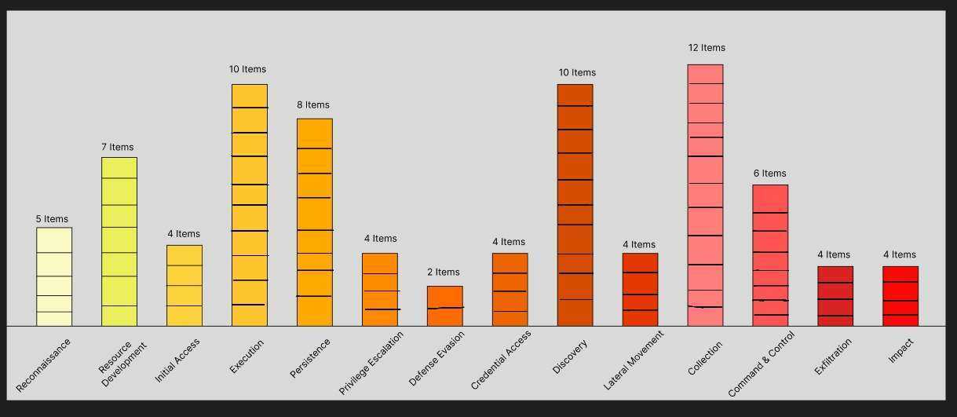
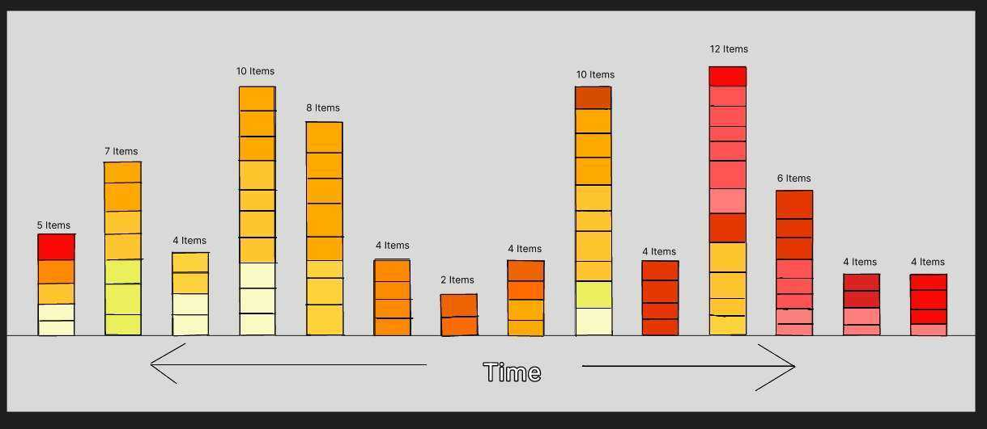
Initial Designs:
Color based on Tactics

Slide 8
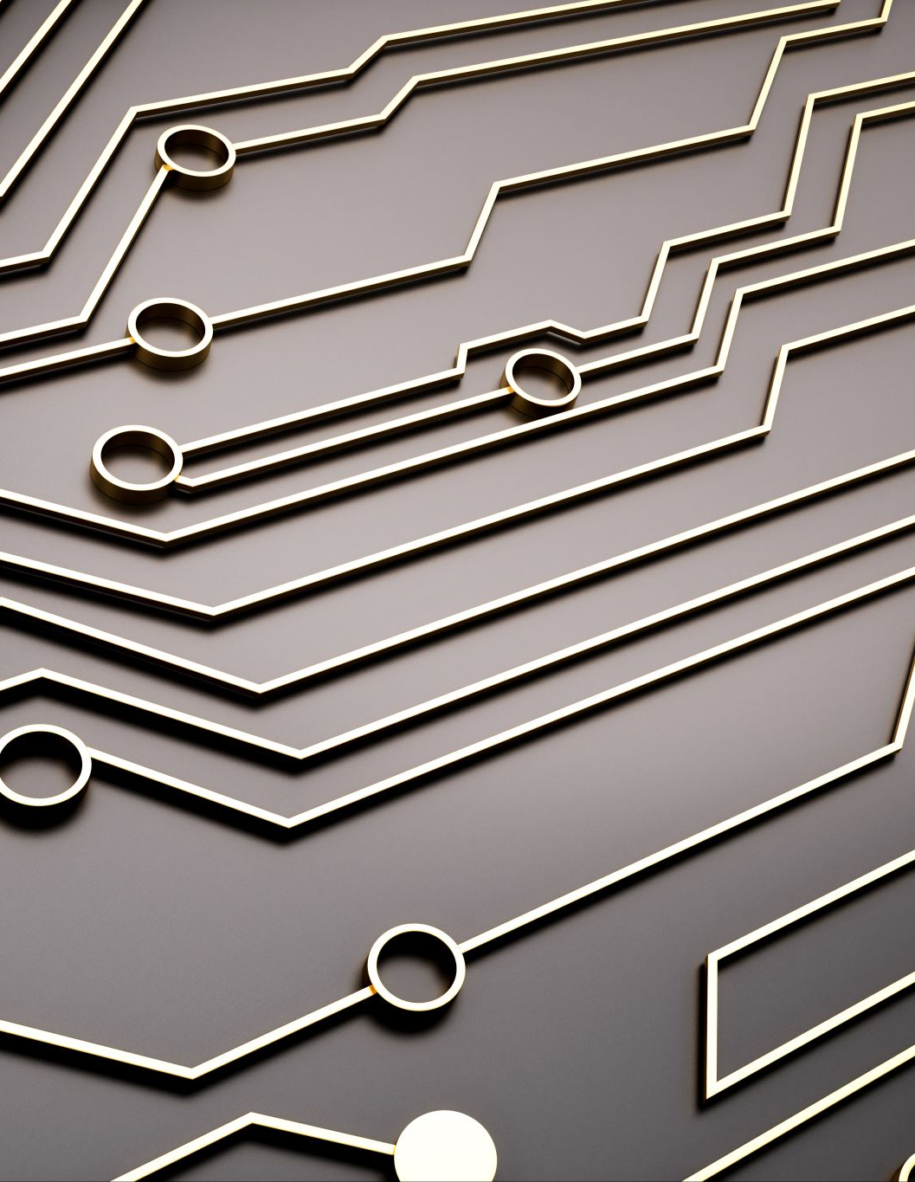
Final Product Improvements:
Each card is expandable.
Color-coded Timeline View.
Improved data compatibility.
Improved user interface.
Notes:
PICTURES~ Our product prototypes with an arrow to new product faded like intro

Slide 9
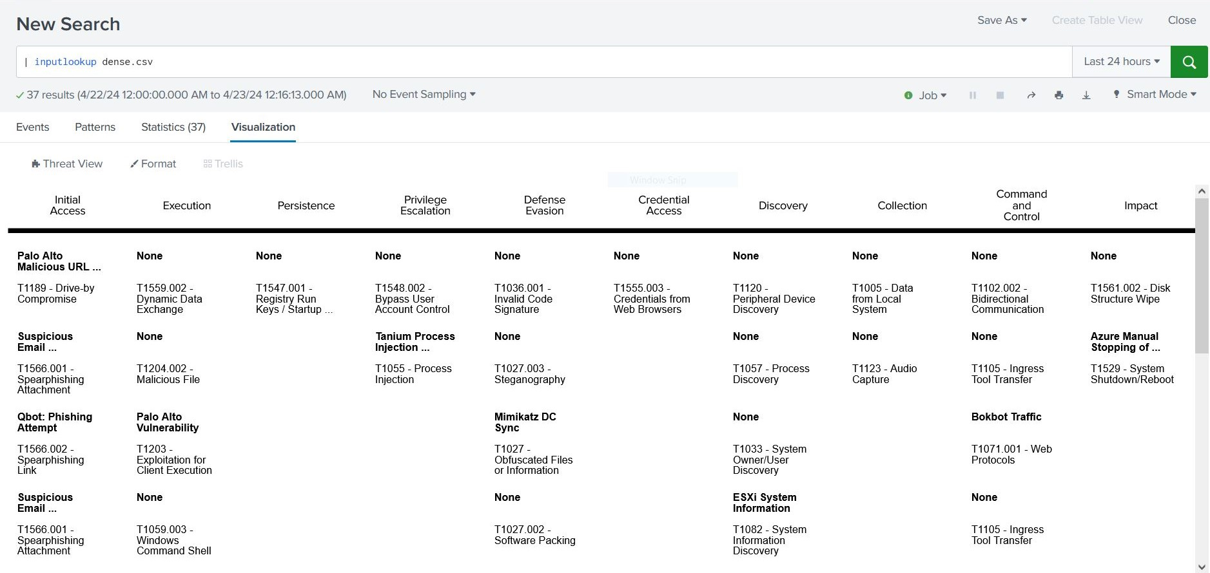
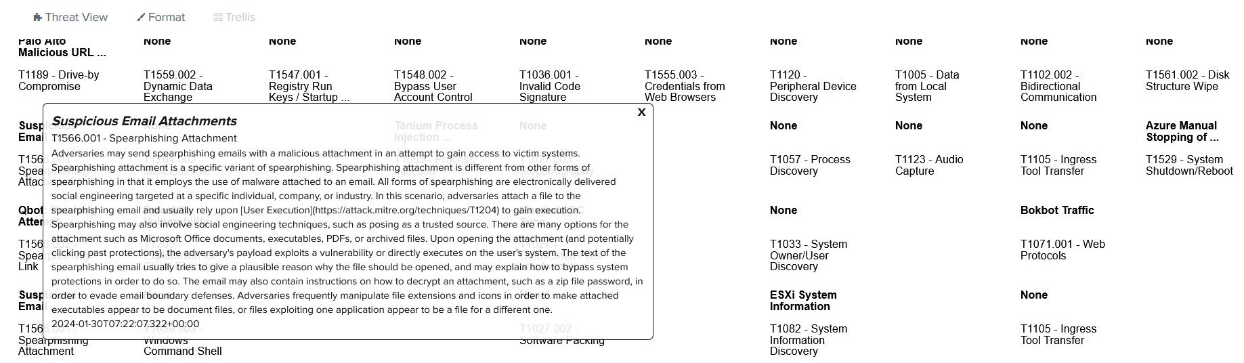
Threat View: Tactic

Slide 10
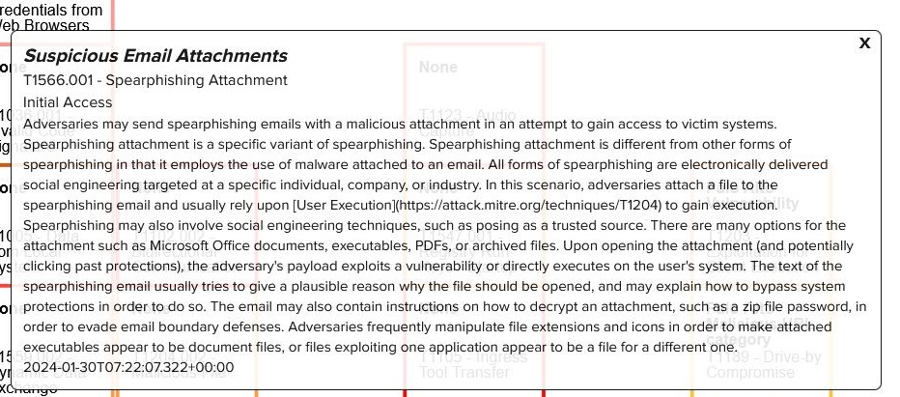
Threat View: Timeline

Slide 11
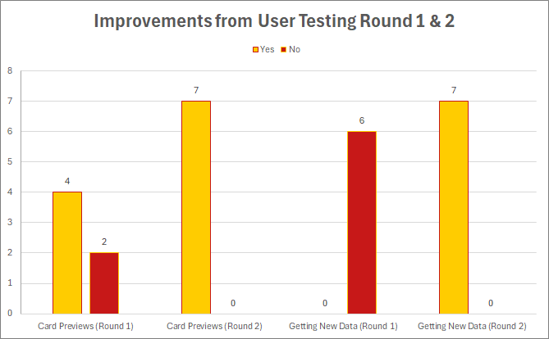
Testing Results:
Problem-Features:
Getting updated data.
Card previews unclear.
After Adjustments:
Users retrieving updated data increased by 100%
Success with opening card previews increased by 49.25%
Notes:
Round 1 to 2 improvement
Ex – We had issues with features 1 & 2, and when we fixed it we had an improvement of X percent on those items

Slide 12
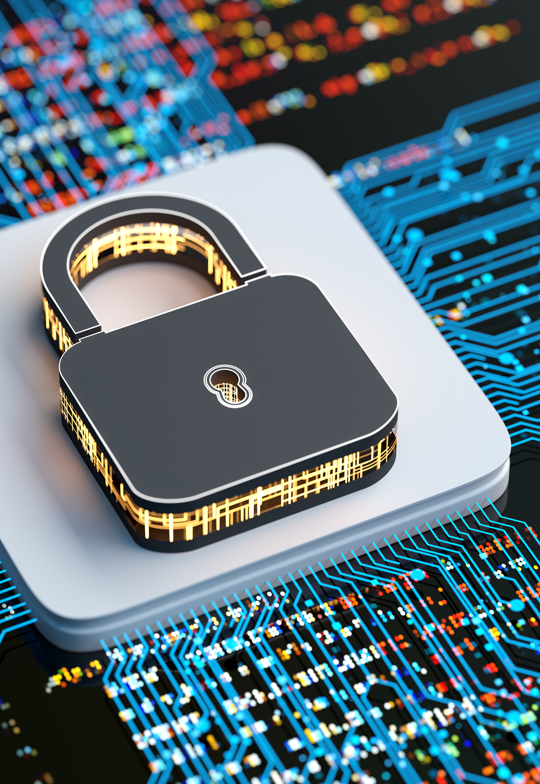
Contribution to Human Computing & Lasting Impact
Provides enhanced cyberthreat analysis.
Increases efficiency for cyber analysts.
Speeds-up threat detection.
Allows for quicker threat mitigation.

Slide 13

Thank you for listening!

